Slide 1
Battle of Neighborhoods
Chicago, Illinois
BY
Touqeer Ahmed

Slide 2
Problem Statement
To recommend the best neighborhood to live, to buy a house, to rent an apartment or build a restaurant etc in Chicago, Illinois .
To understand the similarities and differences between the neighborhoods using Unsupervised K-Mean Clustering Algorithm.

Slide 3
Objective
Collecting the top trending venues in the using Foursquare API(Beautiful Soup, http request)
Forming neighborhood clusters based on venue categories using unsupervised k-mean clustering algorithm(sklearn)
Identifying and understanding the similarities and differences between two chosen neighborhoods to retrieve more insights and to conclude which neighborhood wins over other.

Slide 4
Python packages and Dependencies:
Pandas - Library for Data Analysis
NumPy – Library to handle data in a vectorized manner
JSON – Library to handle JSON files
Geopy – To retrieve Location Data
Requests – Library to handle http requests
Matplotlib – Python Plotting Module
Sklearn – Python machine learning Library
Folium – Map rendering Library

Slide 5
Work flow
Web Scraping and Data Wrangling
Top Trending Places Extraction and Clustering
Decision Making based on the clustered neighborhoods, Population Distribution, School Ratings, Median House Price Analysis

Slide 6
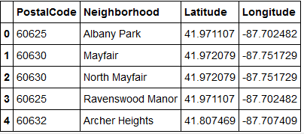

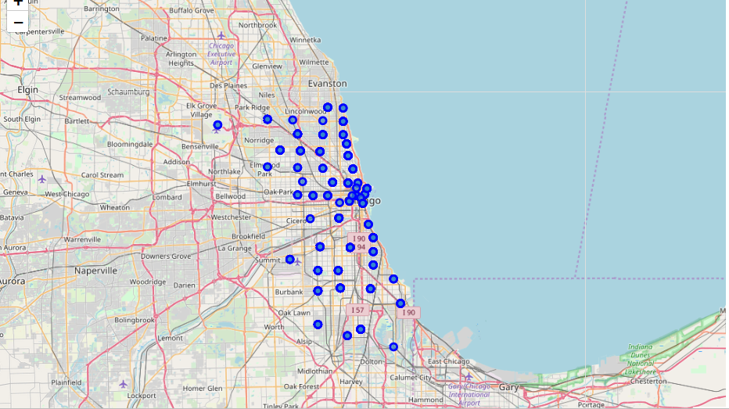
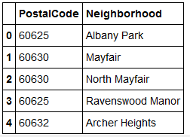
Web Scraping and Data Wrangling
Beautiful Soup
Google Maps API
Collecting Neighborhood/Postal code
http://seattlearea.com/zip-codes/
To Collect Geographical Data
Folium Visualization for Chicago Neighborhood

Slide 7
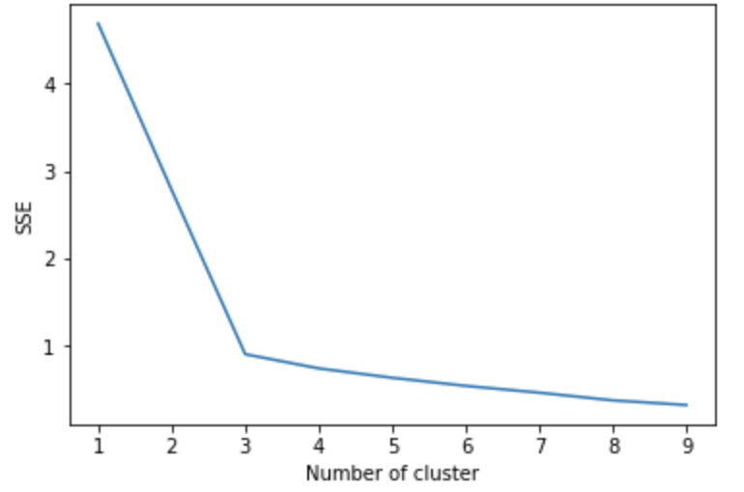
Venues Extraction using Four Square API and Clustering
Four Square API Calls to Collect Neighborhood Venue Category and LAT/LNG
Venues Grouped by Neighborhood 289 Unique Venues
Cluster 1
One Hot Encoding to Convert Labels into Numbers
K-Means Clustering
Cluster 2
Silhouette Score
Elbow Method
Cluster 3

Slide 8
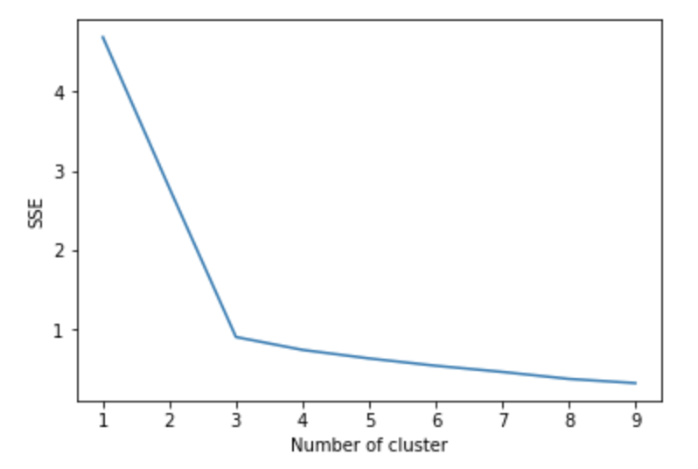
Elbow Criterion Method
Elbow method is to run k-means clustering on a given dataset for a range of values of k and for each value of k and calculate sum of squared errors (SSE).

Slide 9
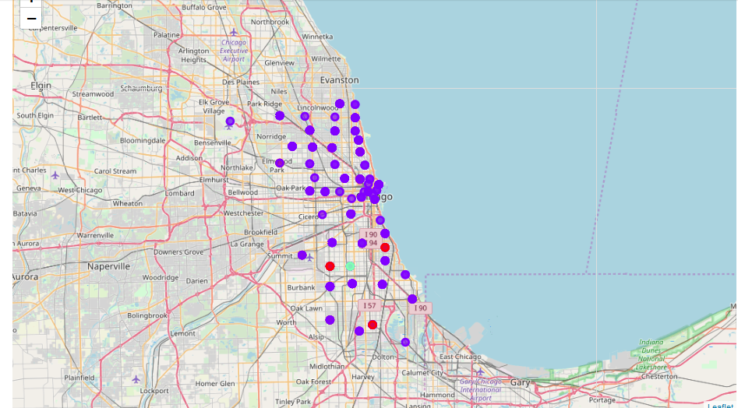
Cluster Neighborhood

Slide 10
sklearn.metrics.silhouette_score
The Silhouette Coefficient is calculated using the mean intra-cluster distance (a) and the mean nearest-cluster distance (b) for each sample.
The formula for the Silhouette Coefficient of a sample is
(b - a) / max(a, b).
The best value is 1 and the worst value is -1. Values near 0 indicate overlapping clusters. Negative values generally indicate that a sample has been assigned to the wrong cluster.

Slide 11

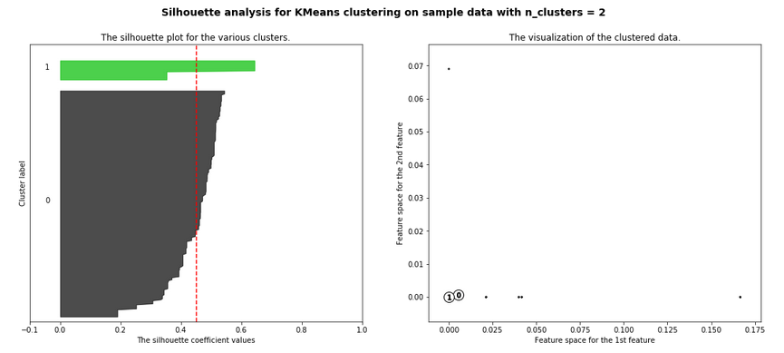
Siluhouette Score and Cluster Visualizations

Slide 12
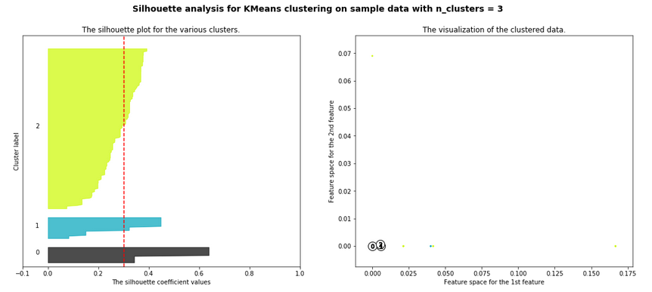
Siluhouette Score and Cluster Visualizations

Slide 13
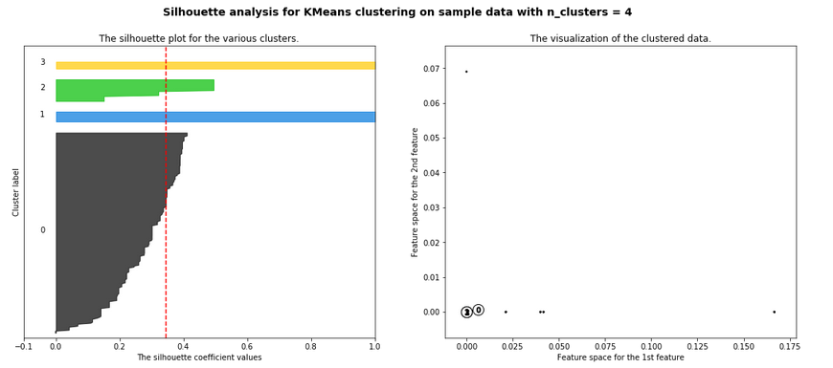
Siluhouette Score and Cluster Visualizations

Slide 14
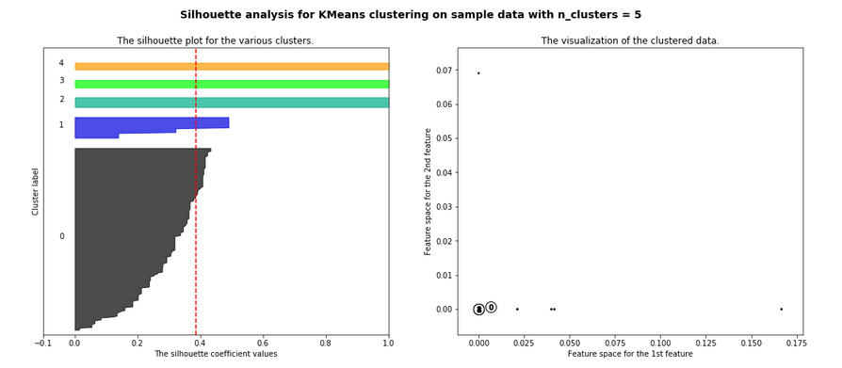
Siluhouette Score and Cluster Visualizations

Slide 15







Neighborhood 1
Neighborhood 2
Decision Making
Population Distribution Analysis
Median House Price Analysis
School Ratings Analysis
Cluster Analysis
Winning Neighborhood

Slide 16
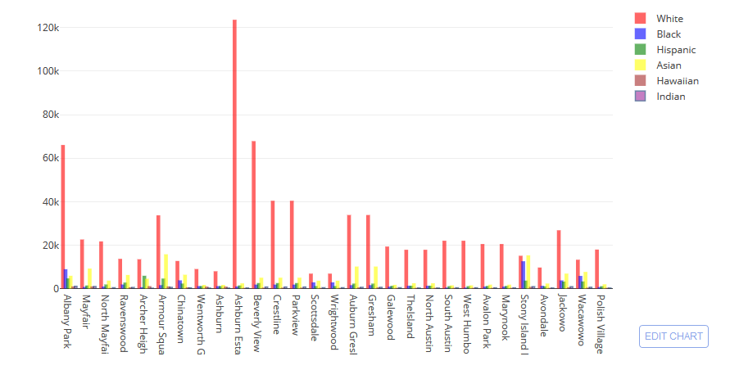
POPULATION DISTRIBUTION

Slide 17
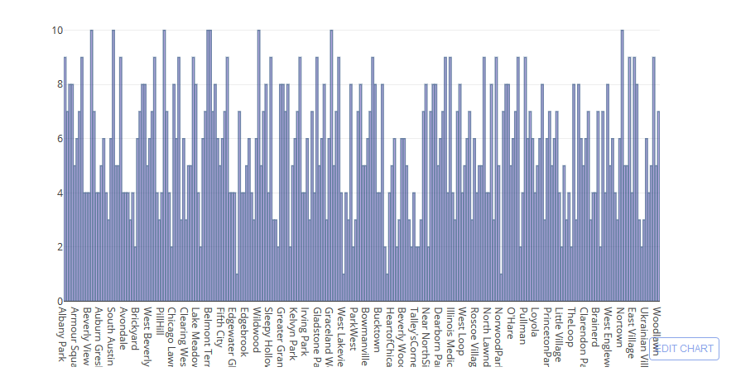
AVERAGE SCHOOL RATINGS

Slide 18
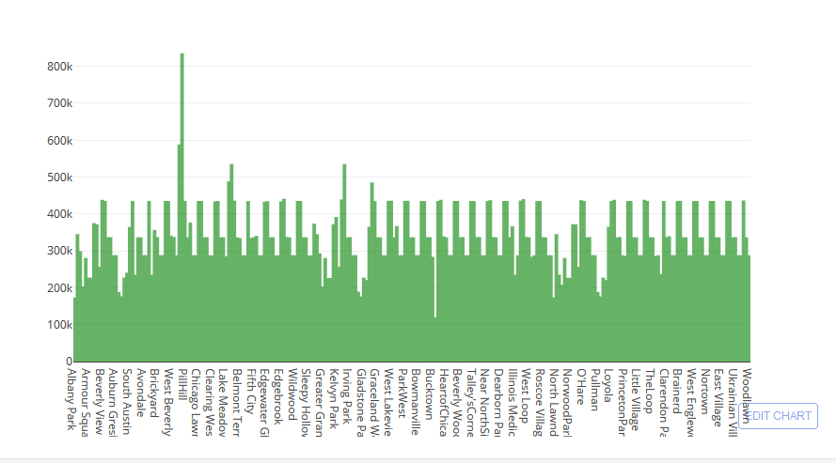
MEDIAN HOUSE PRICE

Slide 19
Comparison between Neighborhoods - Chicago
Armour Square and Parkview
Now lets compare 2 neighborhoods to choose one that best matches our requirements as given below
1. More Indian Population
2. Higher School Rating
3. Reasonable Housing Price in the Range of 300k to 500k
4. Comfortable Neighborhoods

Slide 20
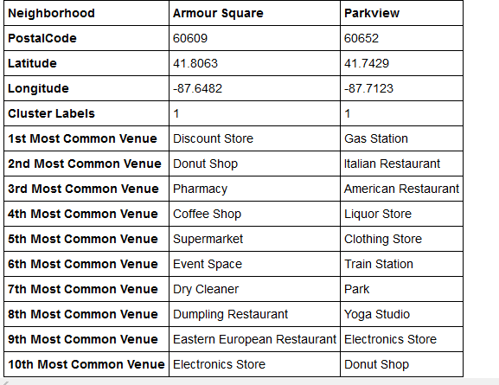
Neighborhood Venues

Slide 21
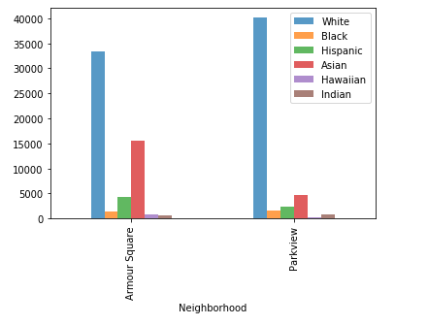

Population distribution

Slide 22
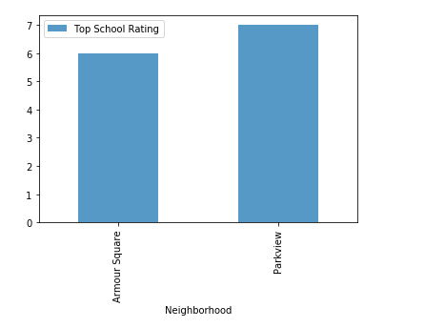
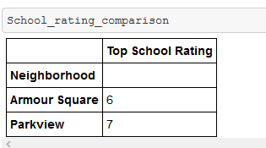
School ratings

Slide 23
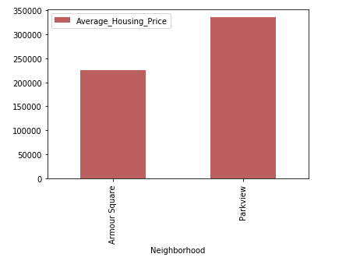
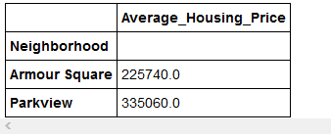
Average housing price

Slide 24





Conclusion
This Analysis concludes that compared to Bellevue ,
Parkview has the higher number of population (including Indians)
Good school rating of 7
Reasonable average housing price of approximately 330k
also top 10 common venues shows Parview has got a good neighborhood with Gas station, Italian and American Restautrant, Train Station, Clothing Store , Park, Donut Shop and many more.
Hence Parview wins over Armour Square!

Slide 25


